Slide 1
SMART RETAIL ANALYTICS FOR FASHION SALES
Name : HEMALA R
Mentor : PANKAJ DOUNDEY

Slide 2
TABLE OF CONTENTS
Problem Statement
Functional Diagram
Tools and Technologies
Technical Diagram
Dataset
Schema Modeling
Key Performance Indicators

Slide 3
Problem Statement
A fashion retail shop lacks online presence and relies solely on a basic POS system for daily sales. Manual tracking leads to inventory stockouts, poor sales trend insights, and missed opportunities in customer preferences for seasonal apparel, resulting in revenue loss and inefficient operations.
The project aims to digitize POS data into a scalable analytics system for predictive insights on fashion sales patterns, real-time inventory optimization, employee performance tracking, and customer segmentation through an intuitive Power BI dashboard.

Slide 4

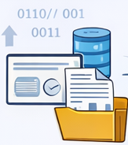



Functional Diagram
Offline Store
Collect Offline
Data Daily
Process and Analyze Data
KPIs & Insights
Data Driven Decisions

Slide 5
TOOLS AND TECHNOLOGIES
Phase | Azure Tool
Data Ingestion | Azure Data Lake Gen2
Orchestration | Azure Data Factory
Data Processing | Azure Databricks
Data Warehouse | Azure Synapse
Visualization | Power BI

Slide 6
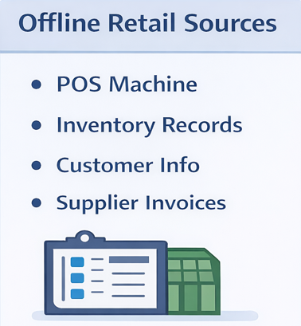
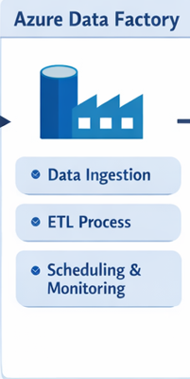
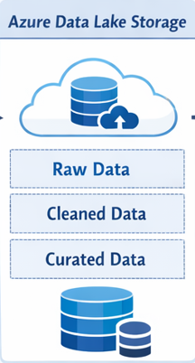
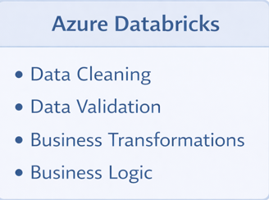
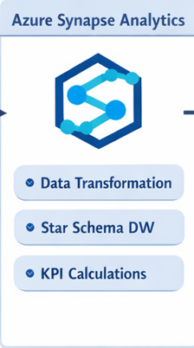
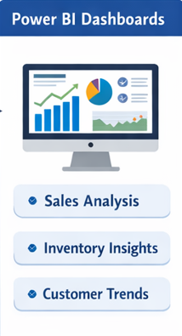
Technical Diagram

Slide 7
DATASET
The dataset is divided into one fact table and multiple dimension tables.
Fact_Sales → Central transactional table
Dim_Date → Time-based analysis
Dim_Product → Category, size, color, brand
Dim_Customer → Customer behavior tracking
Dim_Employee → Sales contribution per staff
Dim_Store & Dim_Branch → Location-based analysis
Dim_Promotion → Discount effectiveness
Dim_Inventory → Stock level monitoring
Dim_Supplier → Supply chain insights

Slide 8
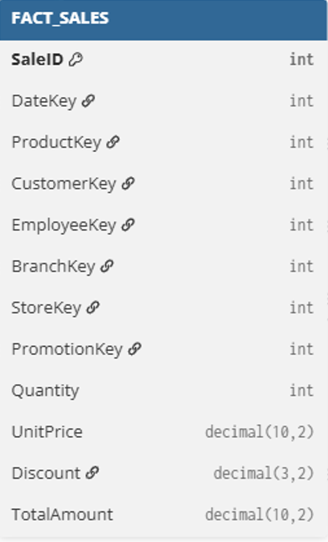
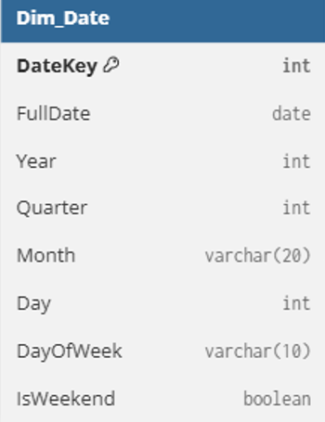
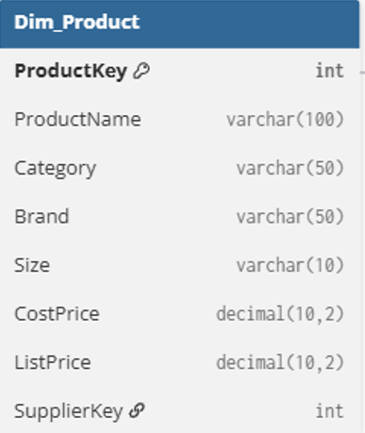
FACT AND DIMENSIONS TABLES

Slide 9
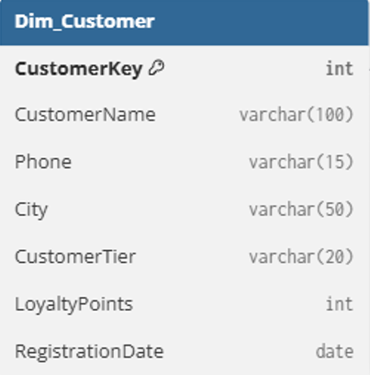
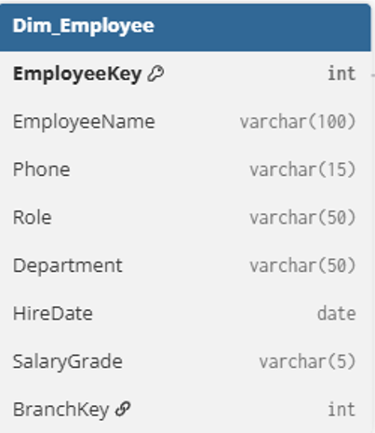
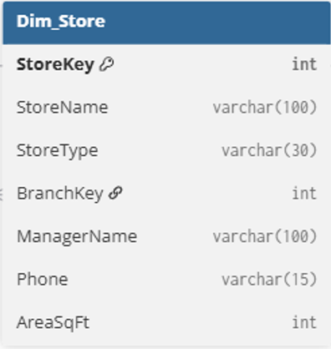
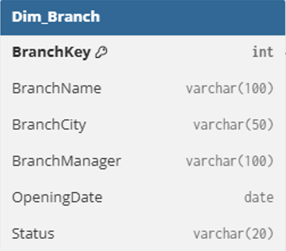
DIMENSIONS TABLES

Slide 10
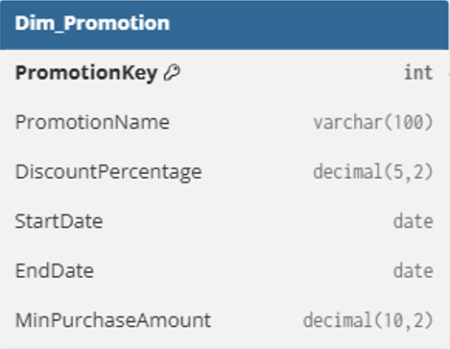
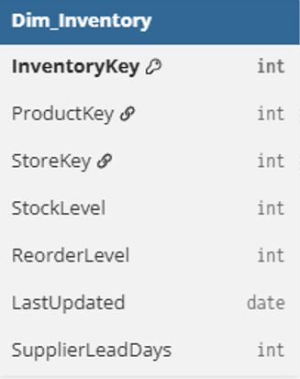
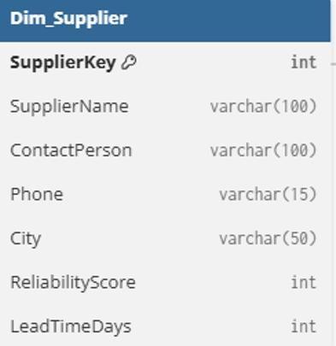
DIMENSIONS TABLES

Slide 11
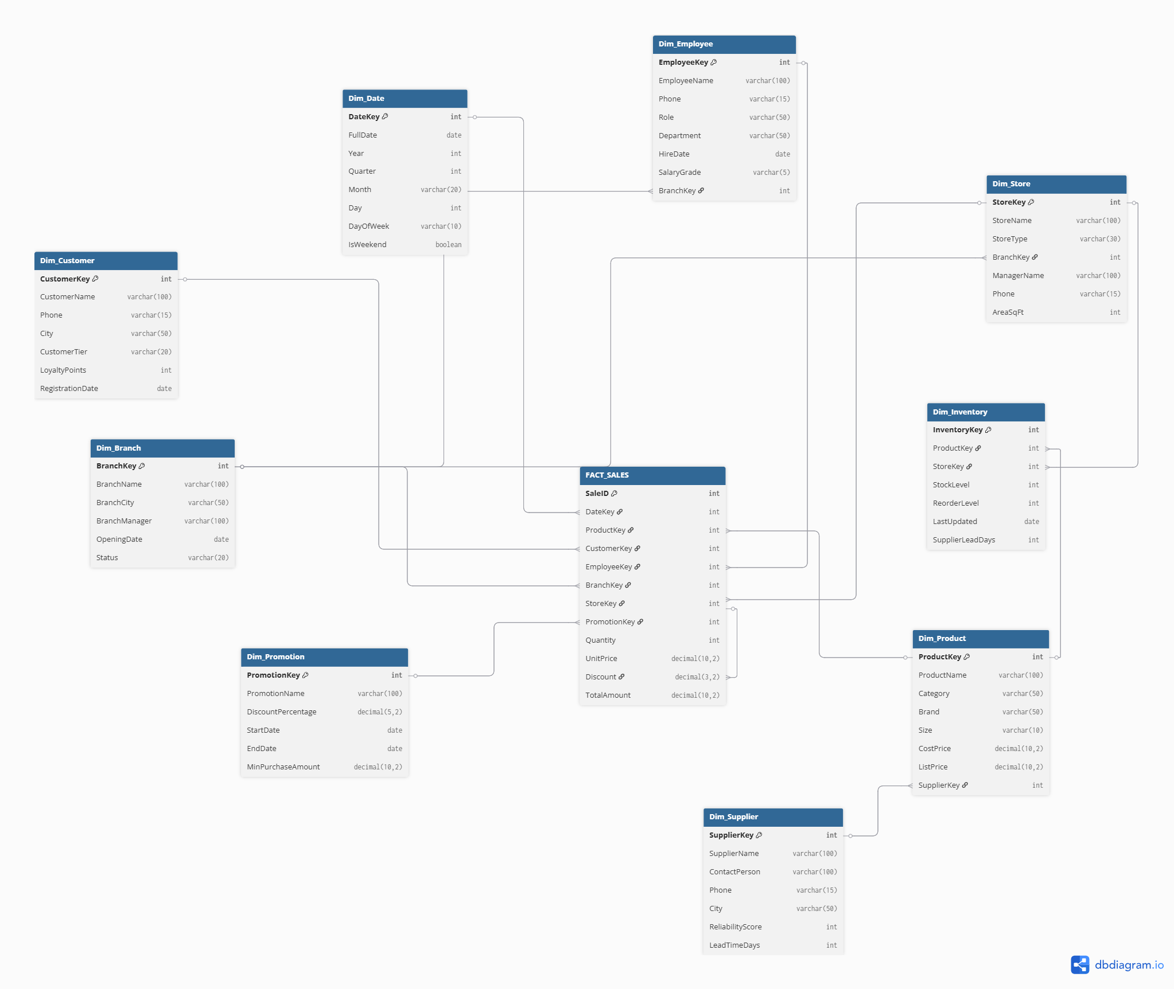
Schema Modelling

Slide 12
Key Performance Indicators
Positive KPIs
Total Revenue
Branch-wise revenue share
Employee Sales per Head
Negative KPIs
Stockouts
Discount Leakage
Customer Churn

Slide 13
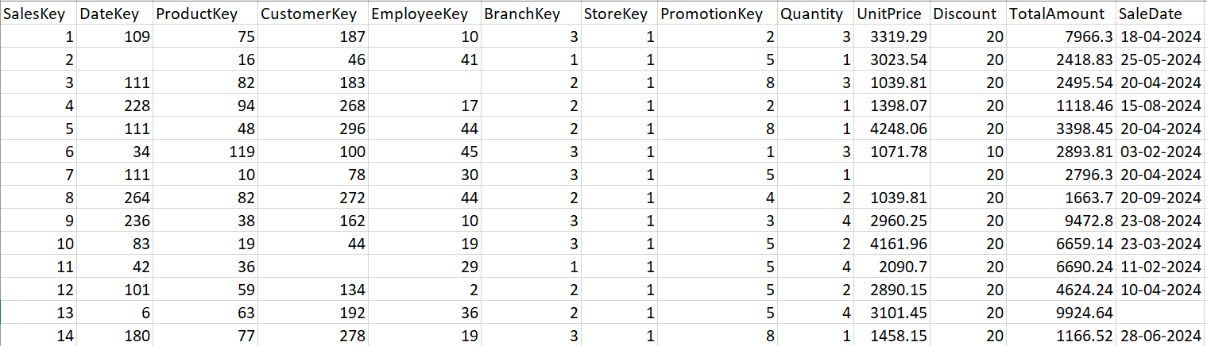
Dataset
Fact_Sales

Slide 14
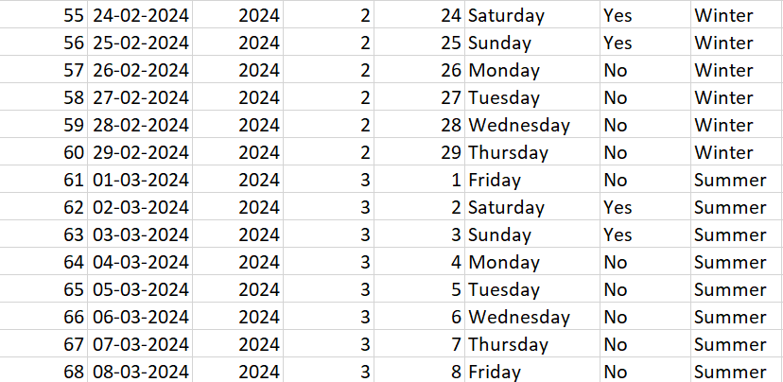
Dataset
Dim_Date Table

Slide 15
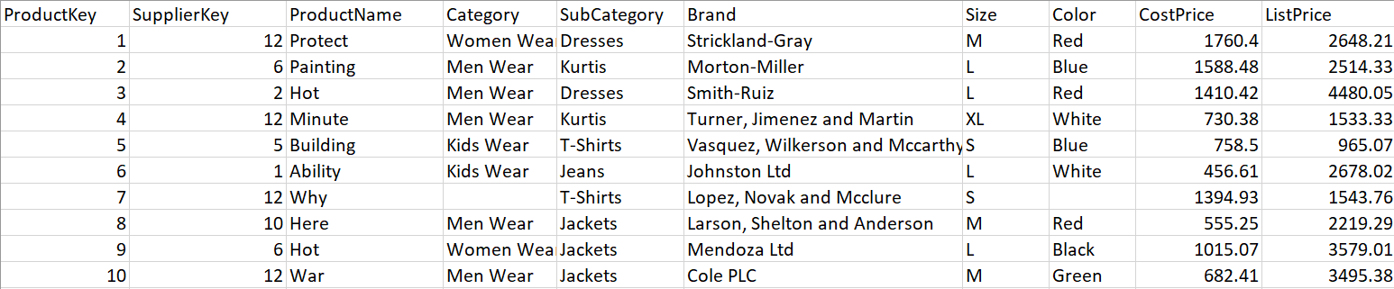
Dataset
Dim_Product Table

Slide 16
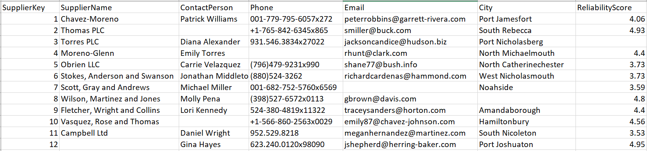
Dataset
Dim_Supplier Table

Slide 17
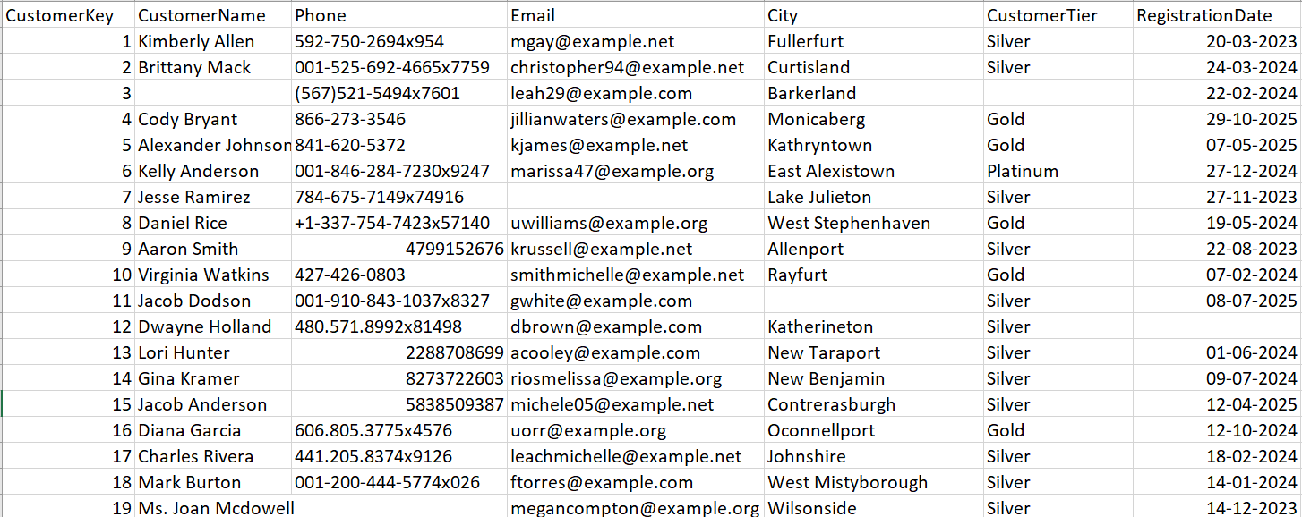
Dataset
Dim_Customer Table

Slide 18
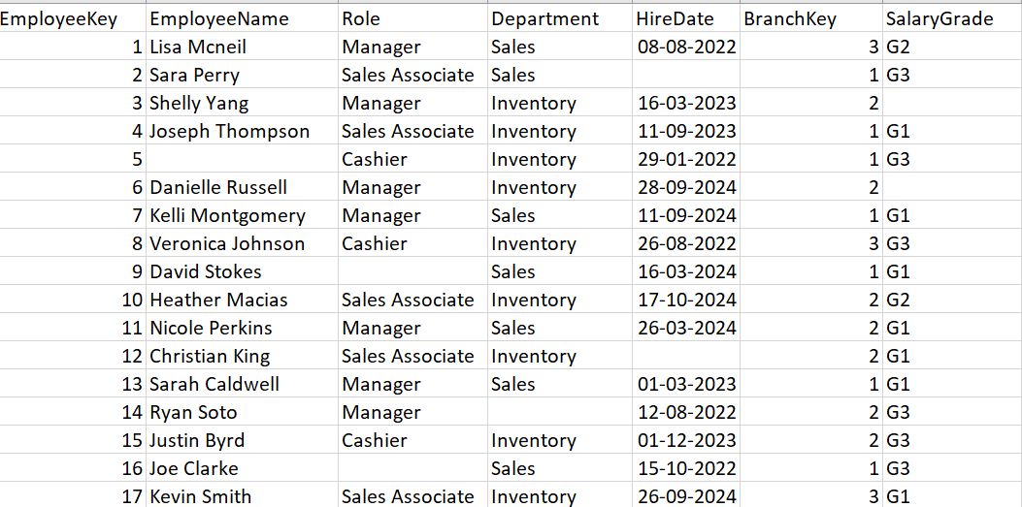
Dataset
Dim_Employee Table

Slide 19
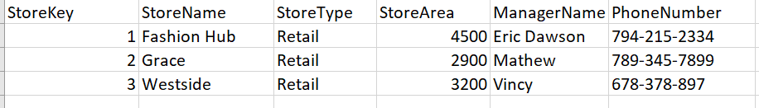
Dataset
Dim_Store Table

Slide 20
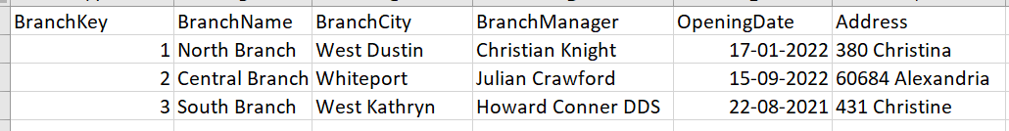
Dataset
Dim_Branch Table

Slide 21
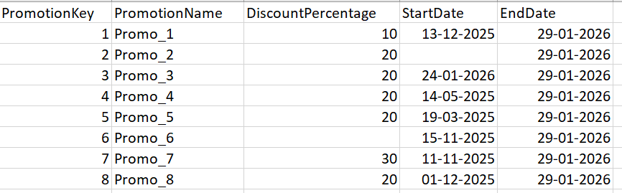
Dataset
Dim_Promotion Table

Slide 22
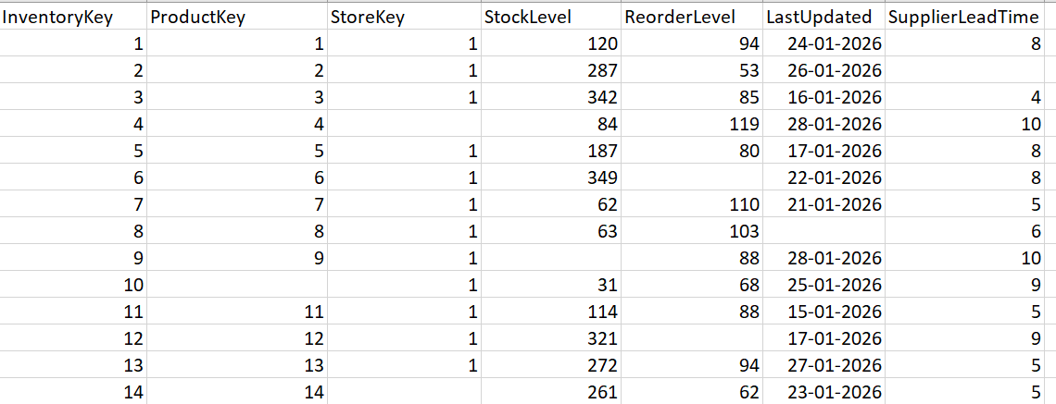
Dataset
Dim_Inventory Table

Slide 23


